Slide 1
Lesson 2
Generalized Linear Models

Slide 2
Introduction
In the first lecture we considered data which has normally distributed errors or could be made normal
Here, we will consider some common alternative mathematical distributions that describe non-normal data
We will also show how these non-normal distributions can be combined with normal variables using Generalized Linear Models.

Slide 3

Assumptions of linear models
$$y_{ijk}= β_{0}+β_{1}x_{1}+β_{2}x_{2} +β_{3}x_{1}x_{2}+ε_{ijk}$$
Linear models make many assumptions, including:
The model makes biological sense/ physical sense
Additivity (terms are added together)
Linearity
Independence of errors (LATER)
Homoscedasticity – equal variance of errors
Normality of errors.

Slide 4
Alternative Distributions
Some data which is typically not normal:
Proportions (e.g. infection rates, survival rates)
Variance will be ∩ - shaped function of mean
Count data (insects on a leaf, trees in a plot)
Often many zeroes – variance will increase with mean
Binary response (dead / alive; present / absent)
Non-normal

Slide 5
Importantly,
These data can be described by known distributions
As such they can be described mathematically
And we can make inferences about them using those mathematical properties

Slide 6
Normal distribution
Symmetric, continuous, unimodal, unbounded
Used for:
continuous variates (usually unbounded)
Numerous data (growth, flow rates, mass, etc)
Properties:
mean (μ) and variance (σ²)
σ² constant and indept. of μ
Unbounded: (-∞ , ∞)

Slide 7
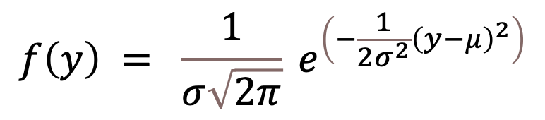
Normal distribution
Probability density function (pdf)
$$f\left(y\right) = \frac{1}{σ\sqrt{2π}} e^{\left(−\frac{1}{2σ^{2}}{\left(y−μ\right)}^{2}\right)}$$

Slide 8
Poisson distribution
Asymmetric, discrete, unimodal, bounded below
Used for:
variables describing the number of occurrences of a particular event in an interval of time or space, i.e. count data (e.g. # insects on leaves)
Properties:
μ = σ² (=λ)
Bounded below: [0,∞)
Approx. normal for μ >> 0
but incr. +ve skew as μ → 0

Slide 9
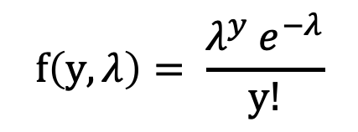
Poisson distribution
Probability density function (pdf)
$$f\left(y,λ\right)= \frac{λ^{y} e^{−λ}}{y!}$$

Slide 10
Binomial distribution
Asymmetric, discrete, unimodal, bounded both sides
Used for:
Binary data (yes/no)
summed proportions of binary data in a given number of trials (n trials) (binomial data)
Properties:
μ = np, the prob of success (‘yes’)
[ (1 - p) = prob. of observing failure ]
σ² = μ (1 – μ)
Bounded both sides: [0,1]
0 0.1 0.2 0.3 0.4 0.5 0.6 0.7 0.8 0.9 1.0

Slide 11
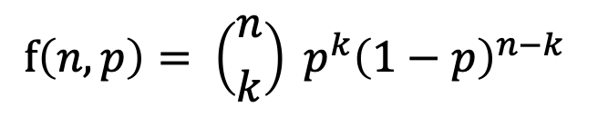
Binomial distribution
Probability density function (pdf)
$$f\left(n,p\right)= \left({n \atop k}\right) p^{k}{\left(1−p\right)}^{n−k}$$

Slide 12
Gamma distribution
Asymmetric, continuous, unimodal, bounded below
Used for:
continuous variates that are bounded below (e.g. rain)
zeros in poisson data (negative binomial model)
prior for several distributions (e.g. Normal, Poisson)
Properties:
2 parameters: 𝛼 (shape), 𝛽 (rate)
mean (μ = 𝛼 / 𝛽)
variance (σ² = 𝛼 / 𝛽²)
Bounded below: (0 , ∞)

Slide 13
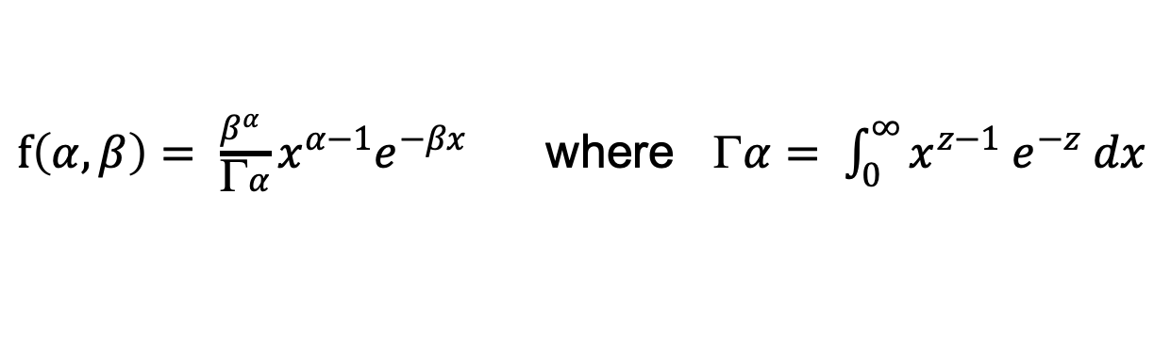
Gamma distribution
Probability density function (pdf)
$f\left(α,β\right)= \frac{β^{α} }{Γα}x^{α−1}e^{−βx}$ where $α= \int_{0}^{∞}{x^{z−1} e^{−z} dx}$

Slide 14
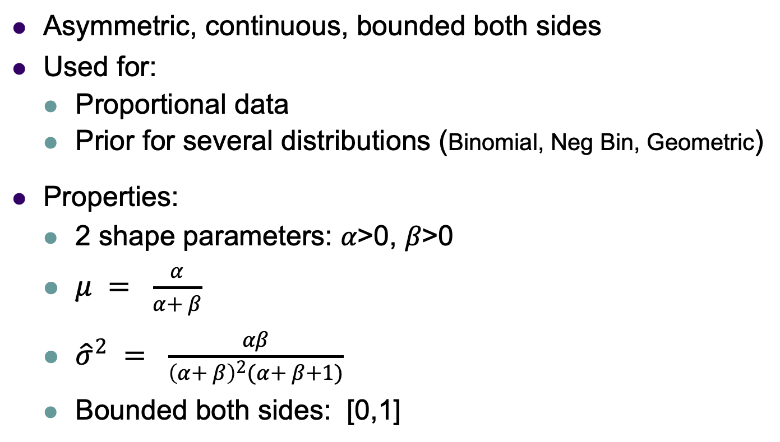
Beta distribution
Asymmetric, continuous, bounded both sides
Used for:
Proportional data
Prior for several distributions (Binomial, Neg Bin, Geometric)
Properties:
2 shape parameters: 𝛼>0, 𝛽>0
$μ = \frac{α}{α+ β}$
${\hat{σ}}^{2} = \frac{αβ}{{\left(α+ β\right)}^{2}(α+ β+1)}$
Bounded both sides: [0,1]

Slide 15
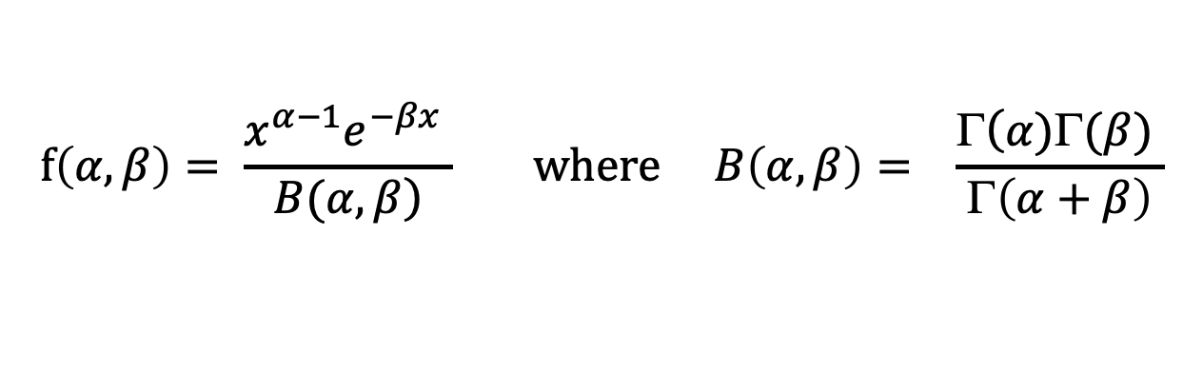
Beta distribution
Probability density function (pdf)
$$f\left(α,β\right)= \frac{x^{α−1}e^{−βx} }{\left.B(α,β\right)} where B\left(α,β\right)= \frac{Γ\left(α)Γ(β) \right.}{Γ\left(α+β\right)}$$

Slide 16
Generalized linear models

Slide 17
Assumptions of generalized linear models
Linear models make many assumptions, including:
The model makes biological sense
Additivity (terms are added together)
Linearity
Independence of errors
Homoscedasticity – equal variance of errors
Normality of errors.

Slide 18

Generalized linear models
Often we seek to explain non-normal response data using explanatory variables just like in LMs
If the response variable can be described with an alternative parametric distribution, then we can analyse the relationship with regression, using generalized linear models (GLMs)
$$y_{ijk}= β_{0}+β_{1}x_{1}+β_{2}x_{2} +β_{3}x_{1}x_{2}+ε_{ijk}$$

Slide 19
A problem example:
Problem: At what age do fledgling birds start to fly in a certain population?
Response variable: birds flying or not:
0 – no, 1- yes; -> data is binary
(summed proportion of successes -> binomial data)
Associated explanatory variable: age (days) :
-> data is ordinal

Slide 20
A problem example: binary response
At all low ages, no birds fly, p(x=10) = 0.
At high ages, all birds fly (=1).
So bounded [0,1]
In-between the proportions change rapidly.
When does the change happen?
Age

Slide 21
Solution: logistic regression
Fit a cont. line that switches from 0 to 1 as the x-values change, i.e. as the proportion of “1”s (“yes”) increases.
A logistic function has this property, so we transform our Y-values to this form using the logit function. Then we can model the transformed responses using regression.

Slide 22
logistic regression -the process
The logit function,
η = ln(p / (1-p))
is the relative chance of success (p) over failure (1-p).
The model actually bins the proportions of successes over small intervals, which shows how this is changing with age

Slide 23
Why not transform the response as we did before?
You may ask yourself: why not just transform the response (Y) to make it normal and apply regular regression?
Transformation often fails to produce data that are normally distributed with homogeneous variance ✗ (consider binary data!)
So, we need an analysis method that accommodates non-normal error distributions in the response

Slide 24
Solution: Generalised Linear Models
A family of statistical methods that unify many classical methods within a single framework.
They cover all distributions in the exponential family (e.g. normal, Poisson, binomial, gamma, beta)
Like general linear models, they can handle a variety of explanatory variable types:
variates, factors, interactions
They allow non-normal error structures

Slide 25
Generalised Linear Models
Three important components:
1. The error structure of the response variable, Y (Normal, Poisson, Binomial, etc)
2. The link function, g(): a transformation of Y that linearizes its values
3. The linear predictor of predictor variables, X_{j} , to regress against the transformed response:

Slide 26
Notes: Link function, g()
It is a transformation function that changes the response to an unbounded, linearized form, η_{i} , suitable for regression.
It does not necessarily make the response normal.
It ensures that estimated values are subject to the bounds of the original distribution of the response.

Slide 27
Notes: Link function, g()
E.g. logit transform changes binomial data to a logistic form
X-range is (-∞ , ∞)
(unbounded, continuous)
Y-range is [0,1]
(bounded like binomial)

Slide 28
Link function
Relates y to the linear predictor η
To calculate a predicted value of y, just use the inverse (reciprocal) of the link function.
Models are fit using maximum likelihood estimation
^
^

Slide 29
Common Link functions
The usual (canonical) link functions are:
Error | Link | Link function
Gaussian | Identity | η = y
Poisson | Log | η = ln(y)
Binomial | Logit | η = ln(p / (1-p))
Unlike μ, η is always unbounded (i.e. it can take any value from + ∞ to - ∞).

Slide 30
Example 2.1. Seal problem (Binomial data)
A behavioural ecologist approached 50 nursing seals several times over a 2 day period and recorded the number of aggressive responses.
She wanted to check if the age of cubs influenced the probability of an aggressive response.

Slide 31
Prediction
How to use chosen models for prediction?

Slide 32
Inverse link functions
Since the GLIM predicts η rather than y, we need an “inverse link” function to make quantitative predictions of μ using our model
Error | Link | Inverse Link function
Gaussian | η = y | ŷ = η
Poisson | η = ln(y) | ŷ = e^{η}
Binomial | η = ln(p / (1-p)) | p = e^{η} / (1+e^{η})

Slide 33
Gaussian model
η = ŷ = a + bX ŷ = a + bX
η
μ
x
x

Slide 34
Poisson model
η = ln(y) = a + bX ŷ = e^{a+bX}
η
μ
x
x

Slide 35
Logistic (Binomial) model
η = ln(p / (1-p)) = a + bX p = e^{a+bX} / (1+e^{a+bX})
η
μ
x
x

Slide 36
Example 2.1 Continued.. Predictions

Slide 37
Maximum likelihood estimation
Understanding how parameters are found in GLMs.

Slide 38
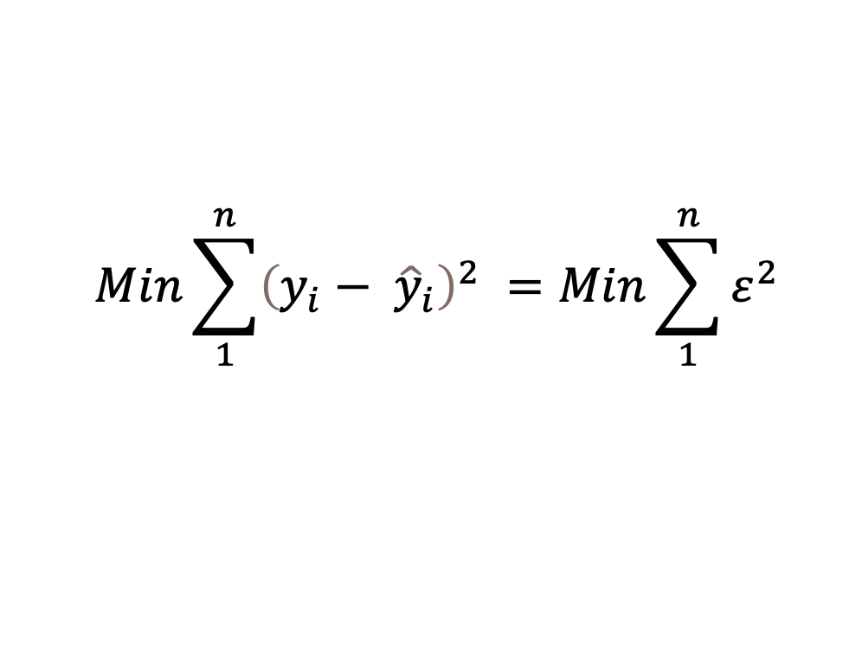
Maximum Likelihood Estimation (MLE)
Before going further we need to introduce the concept of maximum likelihood estimation
Maximum likelihood estimation is an alternative way of estimating the β_{i}’s and σ²
In the first lecture we looked at least squares estimation:
Least squares works for linear models with normally-distributed error; it’s not efficient for alternative distributions
$$Min\sum_{1}^{n}{{\left(y_{i}− {\hat{y}}_{i}\right)}^{2} }=Min\sum_{1}^{n}{ε^{2} }$$

Slide 39
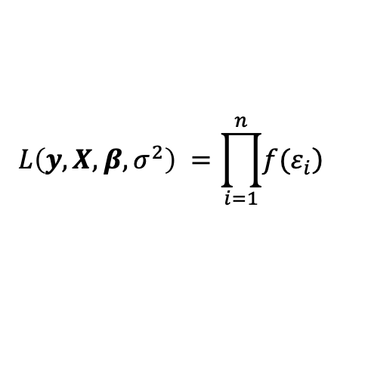
Maximum Likelihood Estimation (MLE)
The MLE is the most likely value of the parameters given the data
MLE uses:
the data information (y, X),
the model formulation (y = Xβ + ε)
a probability density function f(e_{i}) (e.g. Normal, Binomial, Poisson)
Then it constructs a product function for that data called a likelihood function L(θ), where θ are the parameters to be solved (e.g. β₀, β₁, σ)
Then to solve for the L(θ), it looks for the maximum value of L(θ) (the turning point), using derivatives and numeric solutions

Slide 40
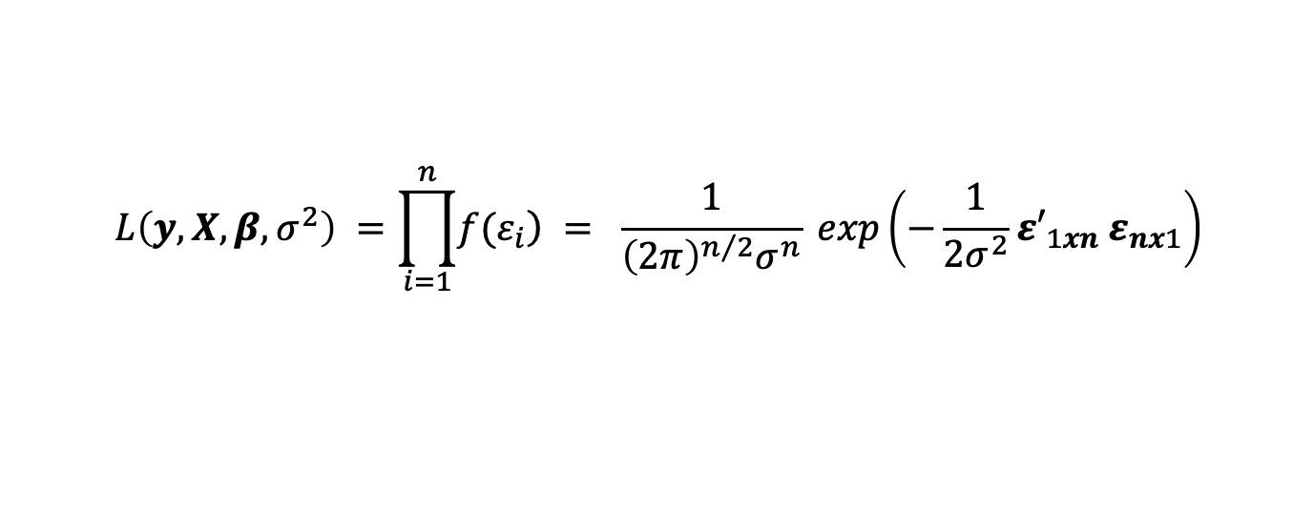
MLE example: normal data
Choose the error distribution formula:
Next, multiply this formula n times, to get the likelihood function (n is for the number of data points):
Now substitute vector ε = y – Xβ to add the actual data

Slide 41
MLE example: normal data
Products are difficult to solve, so take log of L(θ)) to make additive:
Now take the derivatives of unknowns to find the turning points:
for θ = β_{i} , σ²
Turning points represent the maximum likelihoods, and thus the best estimates of β_{i} , σ²

Slide 42
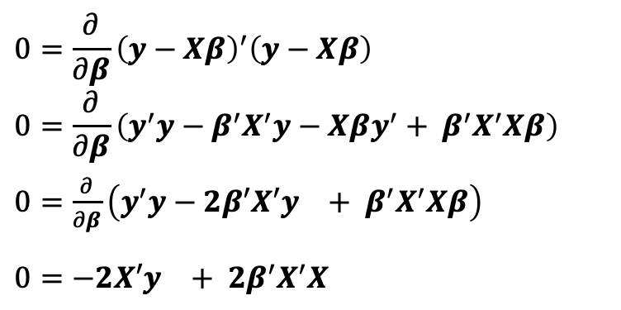
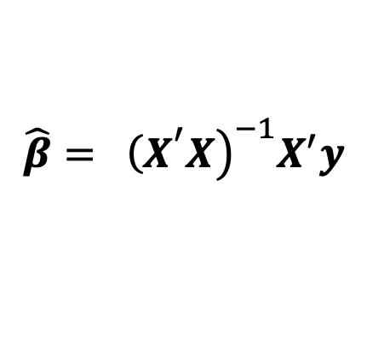
MLE example: normal data
Now solve for β_{i} :
Thus:
(this is the same as the least squares estimate in Lesson 1)

Slide 43
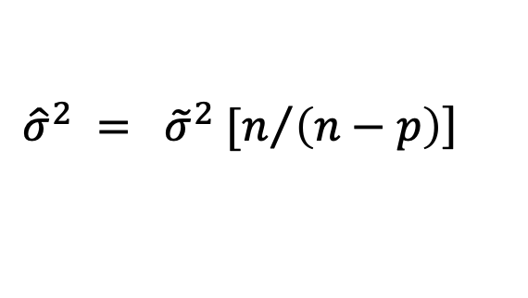
MLE example: normal data
For σ², the MLE generates a downward biased estimate
For normal data (a closed form likelihood), this is easily converted to an unbiased form using algebra:
Note: Restricted maximum likelihood (REML) generates unbiased estimates of σ² for more difficult likelihoods that are not closed form.
$$\left.{\hat{σ}}^{2} = {\tilde{σ}}^{2} [n/{\left(n−p\right)}\right]$$

Slide 44
Further points about MLEs:
MLEs have better statistical properties than LSEs or other estimators.
1. MLEs are BLUP – Best Linear Unbiased Predictors of β_{i}
2. MLEs have lower variance when compared to other unbiased predictors (e.g. RMLEs) i.e. can underestimate σ²
3. MLEs are consistent => they converge to true population parameters with large n
4. MLEs are sufficient => they contain all the information in the sample

Slide 45
MLEs :
We demonstrated how to derive matrix-based formulae for MLE estimates for models with normal errors.
Of course there exist similar formulae for MLE estimates for other types of distributions (Binomial, Poisson, Gamma etc)
MLEs are the standard ways that more complex error distributions get handled.
They are also important to us for evaluating model performance (coming soon)

Slide 46
MLEs :
For simple models, exact differential solutions are possible. For more complex models, this is not possible, and turning points are found using numerical searching.

Slide 47
Inference
How to evaluate whether our model fits the data well?
How to evaluate whether all our predictors are useful for the model?
Because the residuals (e_{i} = y_{i}-ŷ_{i}) are not normal,
we cannot use R² as a goodness-of-fit measure,
we cannot apply the usual diagnostic tests to evaluate residuals
We cannot use t-tests or ANOVA to evaluate model parameters
We must use other tests that don’t assume this

Slide 48
How to make inferences?
Mean comparisons (coefficient significance)
Wald Z-statistic tests (glm equivalent of t-test)
Variance analysis (model significance)
Deviance tests
AIC comparisons

Slide 49
Wald Z test
Test based on the ratio of the mean estimate divided by its standard error
This ratio is ~ normal and follows a fixed normal distribution known as the Z-distribution
Coefficients:
Estimate Std. Error z value Pr(>|z|)
(Intercept) 3.51254 0.03153 111.41 <2e-16 ***
trtI -2.04620 0.09320. -21.95 <2e-16 ***
---
Signif. codes: 0 ‘***’ 0.001 ‘**’ 0.01 ‘*’ 0.05 ‘.’ 0.1 ‘ ’ 1

Slide 50
Deviance
The method uses maximum likelihood estimation
IMPORTANTLY: if a predictor explains data well, then it INCREASES the LIKELIHOOD

Slide 51
Deviance
Three models:
Null model: minimal information explained-highest residuals
y ~ 1 (no predictors)
Fitted model: our prediction model-residual somewhere inbetween null and saturated
y ~ x1 + x2
Saturated model: maximal information explained-lowest residuals
y~ x1 + x2 + x3 +….+ xn
(one parameter for each data pt)
MLE (Saturated)
MLE (Fitted)
MLE (Null)

Slide 52

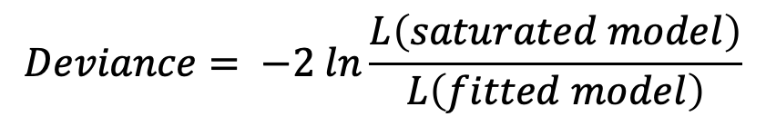
Deviance
MLE (Saturated)
Deviance is difference between likelihoods and the saturated Lik.
E.g. fitted model deviance
To test significance we compare nested deviances using an LRT
MLE (Fitted)
$$Deviance= −2 ln\frac{L\left(saturated model\right)}{L\left(fitted model\right)}$$
MLE (Null)

Slide 53
Deviance in summary()
> summary(mod1)
Call: glm(formula = n.aphids ~ trt, family = poisson, data = aphid2)
Deviance Residuals:
Min 1Q Median 3Q Max
-7.6185 -1.4240 -0.1273 1.4063 4.5301
Coefficients:
Estimate Std. Error z value Pr(>|z|)
(Intercept) 3.51254 0.03153 111.41 <2e-16 ***
trtI -2.04620 0.09320. -21.95 <2e-16 ***
---
Signif. codes: 0 ‘***’ 0.001 ‘**’ 0.01 ‘*’ 0.05 ‘.’ 0.1 ‘ ’ 1
(Dispersion parameter for poisson family taken to be 1)
Null deviance: 1178.83 on 59 degrees of freedom
Residual deviance: 412.14 on 58 degrees of freedom
AIC: 653.93
Number of Fisher Scoring iterations: 5

Slide 54
Likelihood ratio tests on nested models
> #fitted model
> mod1 <- glm(n.aphids~trt, data=aphid2, family=poisson)
> #null model
> mod0 <- glm(n.aphids~1, data=aphid2, family=poisson)
>
> #perform likelihood ratio test
> anova(mod1,mod0,test='Chisq')
Analysis of Deviance Table
Model 1: n.aphids ~ trt
Model 2: n.aphids ~ 1
Resid. Df Resid. Dev Df Deviance Pr(>Chi)
1 58 412.14
2 59 1178.83 -1 -766.7 < 2.2e-16 ***
---
Signif. codes: 0 ‘***’ 0.001 ‘**’ 0.01 ‘*’ 0.05 ‘.’ 0.1 ‘ ’ 1

Slide 55
Example 2.1 Continued.. Deviance

Slide 56
Residual properties:
Using GLMs means that we assume certain residual properties no longer apply:
Most importantly, the residuals are not necessarily normal
We cannot use the usual residual tests applied to LMs
What we need to test is whether our models predict the response data well

Slide 57
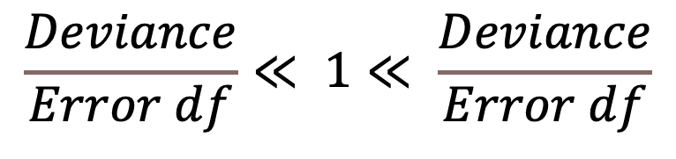
Residual properties: Over- and Under-dispersion
Definition: variance is greater / less than expected based on a particular statistical model
(found in binomial and Poisson models)
Diagnosis:
Can result from:
Patchiness (heterogeneity) in the population variable
An unmeasured factor
A misspecified error distribution
$$\frac{Deviance}{Error df}≪ 1≪ \frac{Deviance}{Error df}$$
Underdispersed
Overdispersed

Slide 58
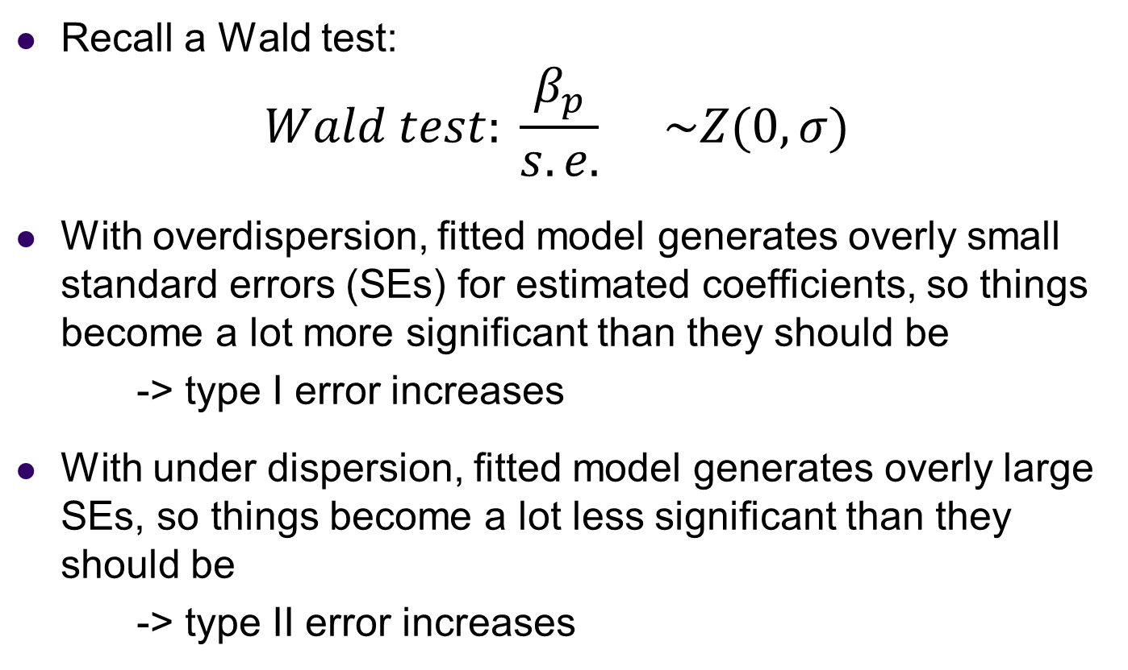
Over- and Under-dispersion: Why do we care?
Recall a Wald test:
$$Wald test: \frac{β_{p}}{s.e.} \sim Z(0,σ)$$
With overdispersion, fitted model generates overly small standard errors (SEs) for estimated coefficients, so things become a lot more significant than they should be
-> type I error increases
With under dispersion, fitted model generates overly large SEs, so things become a lot less significant than they should be
-> type II error increases

Slide 59
Dispersion test code
Very simple to apply in R
Alternatively, use ‘dispersiontest’ from the package ‘AER’ for a formal probability test
> chisq <- sum(resid(mod1, type='pearson')^2)
chisq/df.residual(mod1)
[1] 5.85938
## much greater than 1
dispersiontest(glm1,alternative = "less") #is underdispersed?

Slide 60
Dispersion test visually
We can also check the homogeneity plot
Here you can see that the average standardised residual is >1 for the one group
resids <- resid(mod1, type='pearson')
fitted <- fitted(mod1)
plot(sqrt(abs(resids))~ fitted)
lines(lowess(sqrt(abs(resids))~fitted), col='red')

Slide 61
Dealing with dispersion problems
1. Use Quasi distributions (hatchet fix)
Quasipoisson and Quasibinomial
[these don’t generate real likelihoods]
2. Try alternative proper distributions [likelihoods]
Think more about the properties of the model?
Pure variance inflation: Generalised Poisson models, Negative binomial models; GLMMs with observation level random effects
Mixed process distributions: zero-inflation models; hurdle models

Slide 62
Quasi-likelihood
Solution: allow the variance to have a multiplicative dispersion factor, ϕ
1. Binomial: Var(y) = ϕμ(1-μ)
2. Poisson: Var(y) = ϕμ
Models fit using maximum-likelihood approach & parameter estimates don’t change; residual errors are posthoc rescaled
In R, we specify quasi likelihood in the family command, e.g., family=quasipoisson and then when we conduct the analysis of deviance using an F ratio instead of χ² .

Slide 63
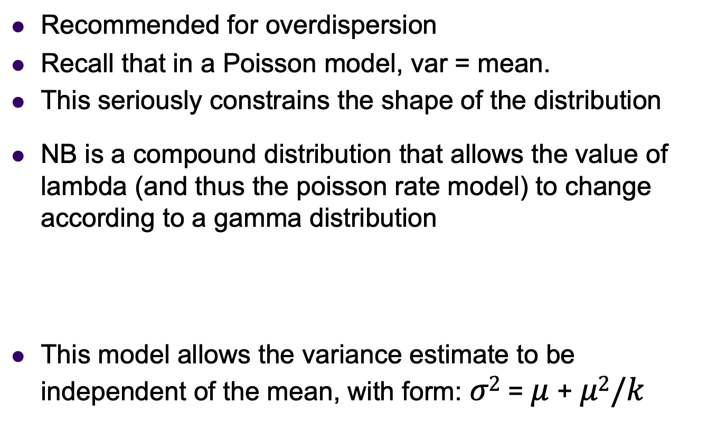
Negative binomial
Recommended for overdispersion
Recall that in a Poisson model, var = mean.
This seriously constrains the shape of the distribution
NB is a compound distribution that allows the value of lambda (and thus the poisson rate model) to change according to a gamma distribution
This model allows the variance estimate to be independent of the mean, with form: $σ2$ = $μ$ + $μ2/k$

Slide 64
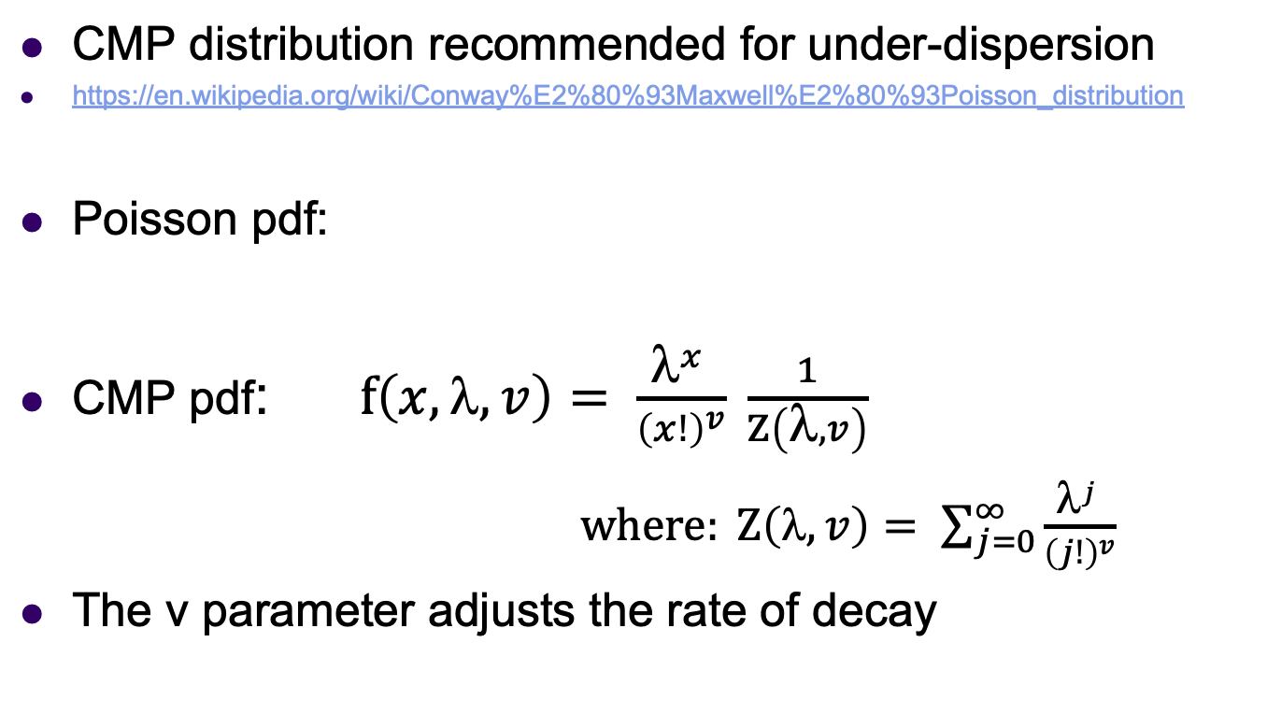
Conway-Maxwell Poisson
CMP distribution recommended for under-dispersion
https://en.wikipedia.org/wiki/Conway%E2%80%93Maxwell%E2%80%93Poisson_distribution
Poisson pdf:
CMP pdf: $f\left(x,λ,v\right)= \frac{λ^{x} }{{\left(x!\right)}^{v}} \frac{1}{Z\left(λ,v\right)}$
$where: Z\left(λ,v\right)= \sum_{j=0}^{∞}{\frac{λ^{j} }{{\left(j!\right)}^{v}}}$
The v parameter adjusts the rate of decay
Normalising
constant

Slide 65
NegBin and CMP
NB and CMP are parametric and can be solved with numerical ML
CMP is directly related to Poisson because when v=1, the model reduces to the Poisson.
CMP can be applied using the ‘COMPoissonReg’ package

Slide 66
Example 2.2. Aphid data (Poisson with overdispersion)
A researcher is interested whether an insecticide is useful in reducing aphid infestations. He applies two treatments (control, insecticide). Then, after a fixed number of days, he counts the number of aphids per leaf area. He also records how long it takes him to check the leaves for aphids, which differs per individual
Open AphidData2.csv
Model aphid counts as a function of treatment only
Plot diagnostics and test for overdispersion
Deal with the overdispersion using pseudopoisson distribution

Slide 67
Comparing models with different distributions – can we use AIC?
This is a question that causes some confusion:
If I think my model is under-/over-dispersed, can I use AIC to compare the model efficiency between the simple model (e.g. Poisson) and the more complex model (e.g. NB)?
My reading of the literature is that this could be taken in a philosophical sense:
EITHER: Yes, its possible for closely related models
OR: No, don’t do it because by definition the model which fixes overdispersion must be preferred.

Slide 68
Comparing models with different distributions – can we use AIC?
certainly true that many statisticians seem to have no problem doing this:
https://math.usu.edu/jrstevens/biostat/PoissonNB.pdf # compares Negative Binomial and Poisson
https://stats.idre.ucla.edu/stata/faq/how-can-i-use-countfit-in-choosing-a-count-model/ #compares a whole bunch of count data variations on the basic Poisson model
I myself have used AIC comparisons between closely related models before: https://www.nature.com/articles/s41598-017-09768-z

Slide 69
Argument against AIC comparisons
Intuitively, the argument against doing AIC comparisons between different models is that the AIC depends on the loglikelihoods of the models [recall: AIC = -2 logLik + 2(k+1) ], and the loglikelihoods themselves will by definition differ because of the differences in the model functions, regardless of the data, so the AIC values generated cannot be meaningfully compared.
The two links below follow this train of thought.
https://stats.stackexchange.com/questions/139201/model-selection-can-i-compare-the-aic-from-models-of-count-data-between-linear
https://stats.stackexchange.com/questions/345069/likelihood-comparable-across-different-distributions

Slide 70
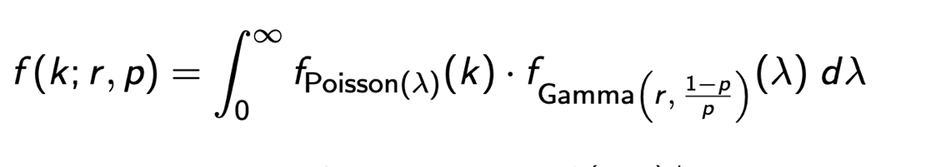
Argument for AIC comparisons
Closely related models are all compound functions that are products of a basic model function and anither function that adjusts the shape. By definition, the compound function will only yield different (and strictly greater) logLik than the basic function when the additional terms significantly improve the fit of the model. If the additional terms do not improve the fit, then the logLik of the basic and compound functions will be the same.
Consider the relationship between the Negative Binomial model and the Poisson model. The Negative Binomial consists of the basic Poisson model multiplied by a gamma distribution.

Slide 71
Other methods to compare?
Some statisticians simply compare models using the Pearson chisq dispersion statistic for each model (this is the value we calculated to evaluate overdispersion) and a visual evaluation of the ‘homogeneity plot” (scaled abs residuals vs fitted values). See:
https://www.theanalysisfactor.com/poisson-or-negative-binomial-using-count-model-diagnostics-to-select-a-model/
You will see that the residuals themselves are not homogeneous, but they are all much reduced in magnitude with the Negative binomial model.

Slide 72
Testing for overdispersion in binary data
This is not a simple problem because the data are 0’s and 1’s.
The overdispersion test can be used, but we can also use something called a binned plot.
Residuals divided into ranges of expected values (bins), then average resids created and compared to 95%CIs created per bin.
If model is true, then 95% of the mean residuals should lie in the 95% CIs

Slide 73
Exercise 2.3. Graduate admissions
A researcher is interested in how variables, such as GRE (Graduate Record Exam scores), GPA (grade point average) and rank (prestige of the undergraduate institution) affect admission into graduate school. The response variable, "admit" is a binary variable (admit/don't admit).
Open binary.csv
Make an appropriate model and run it
Plot residual diagnostics and test for overdispersion
Test whether it explains significant variation (you will need to run the anova() statement comparing fitted and null models

Slide 74

Assessing predictors/ model selection
When you have a lot of predictors in a GLM
How do you decide which predictors are important?
[i.e. How to choose best models?]
$y_{ijk}= β_{0}+β_{1}x_{1}+β_{2}x_{2} +β_{3}x_{1}x_{2}+ε_{ijk}$

Slide 75
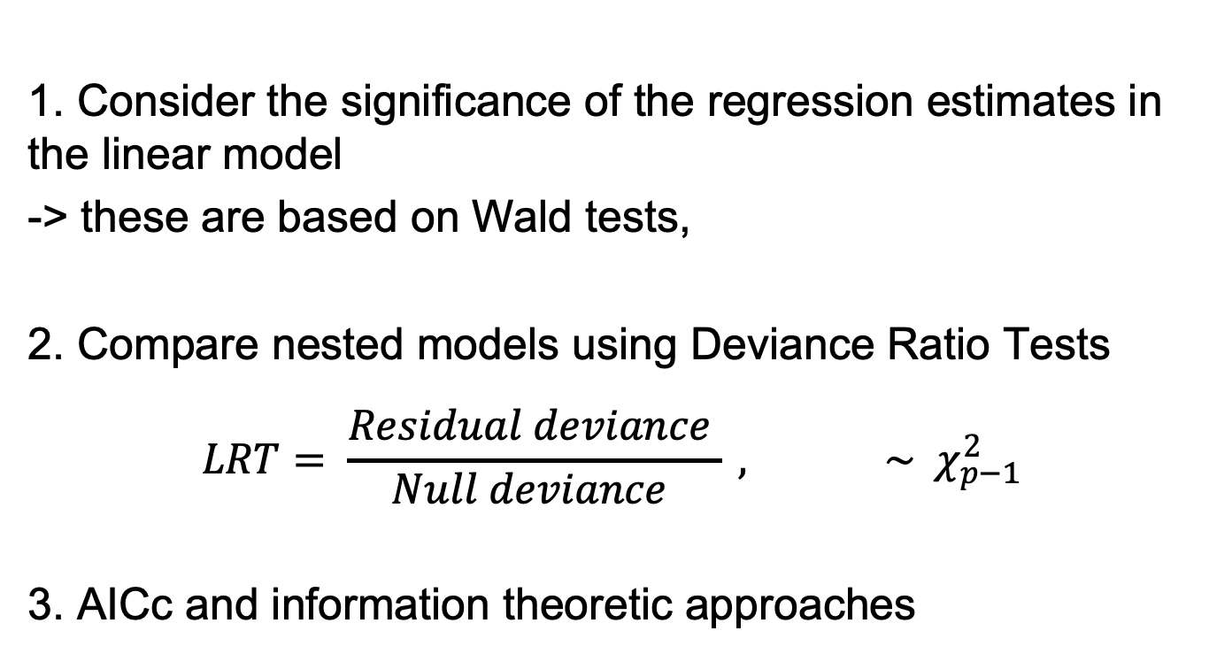
Model selection Methods
Exercise: Return to Admissions problem

Slide 76
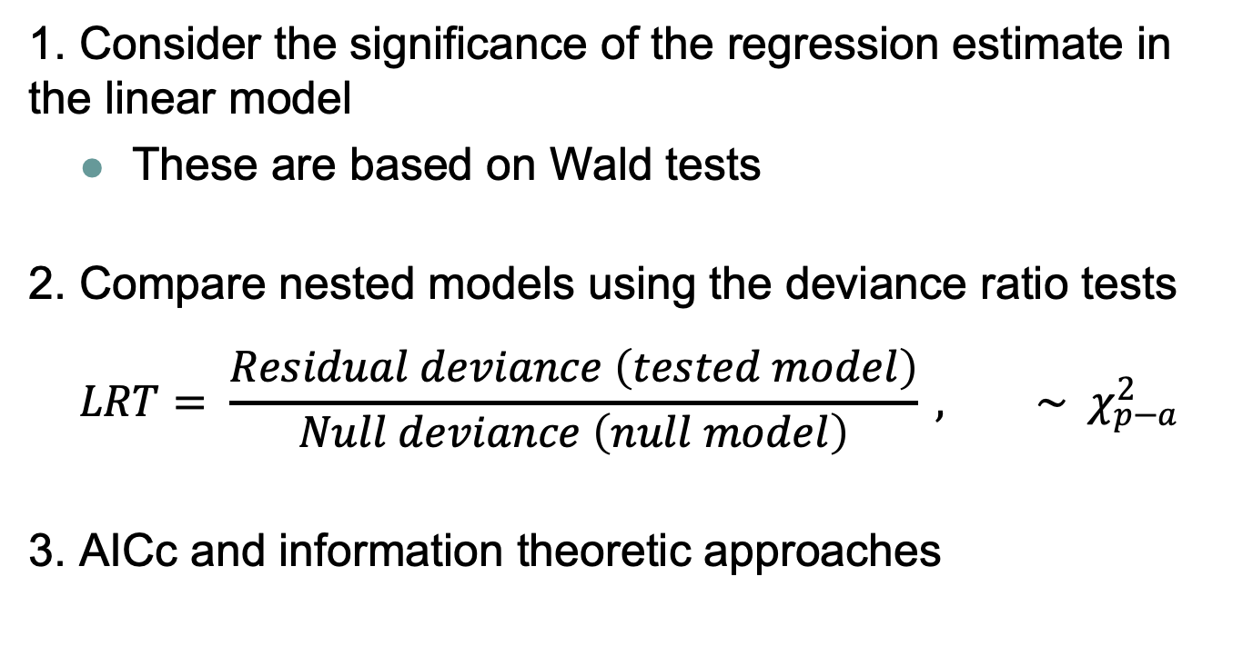
Model selection Methods
1. Consider the significance of the regression estimate in the linear model
These are based on Wald tests
2. Compare nested models using the deviance ratio tests
$$LRT= \frac{Residual deviance \left(tested model\right)}{Null deviance \left(null model\right)} , \sim χ_{p−a}^{2}$$
3. AICc and information theoretic approaches
Exercise: Return to Admissions problem

Slide 77
Assumptions of a GLM
Linear models assumptions:
The model makes biological sense
Additivity (terms are added together)
Linearity
Independence of errors
Homoscedasticity – equal variance of errors
Normality of errors.

Slide 78
End of Lecture 2.

Slide 79
Optional: Exercise 2.4. Children ever born
Question: what factors affect the number of children born to women in Fiji? The dataset ceb.csv contains:
-> Predictors: marriage duration (fact.), residence (fact.), education (fact.)
-> Response: mean number of children ever born per categorical group
-> Number of women sampled per group
Make an additive model using all predictors and test whether they are all necessary using model selection
Plot residual diagnostics and test for overdispersion
Write out the back-transformed model

